Slide 1
A Tutorial of
MongoDB
MIS 634
Business Intelligence & Data Integration - LAB

Slide 2
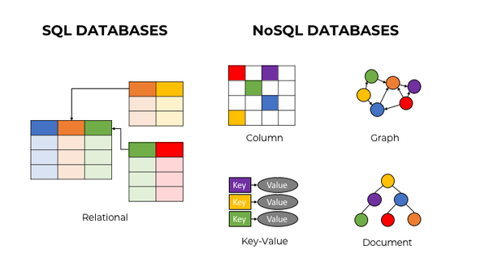
What is NoSQL Database?
“NoSQL” stands for “ Not only SQL”
“NoSQL database” → non-relational database
Features of NoSQL: 1. Flexible Schema； 2. Horizontal Scaling; 3. Fast queries; 4. Easy for Developers.
(Reading: NoSQL vs SQL Databases https://www.mongodb.com/nosql-explained/nosql-vs-sql)
MongoDB is a document database.

Slide 3
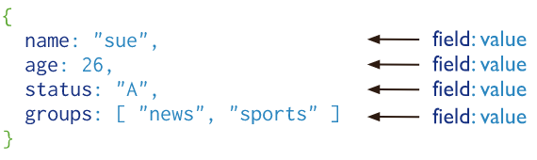
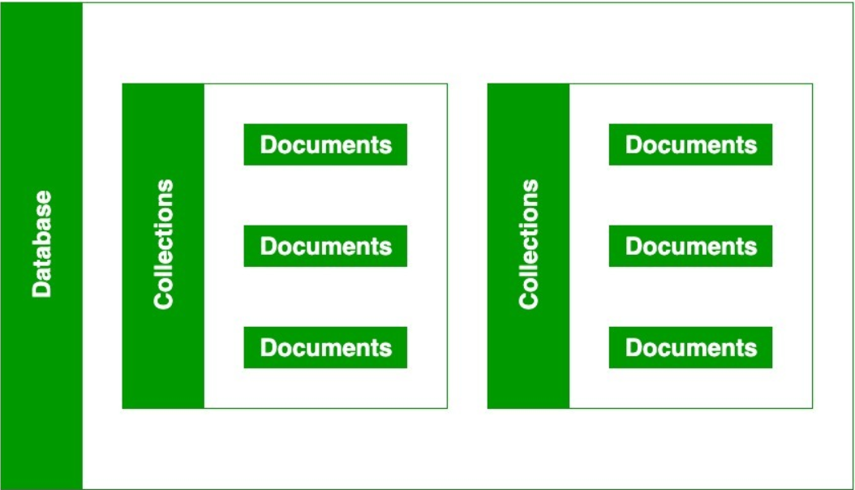
MogoDB: NoSQL Document DB
Document: A way to organize and store data as a set of field-value pairs
Collection: A collection contains multiple documents
A database contains multiple collections.

Slide 4
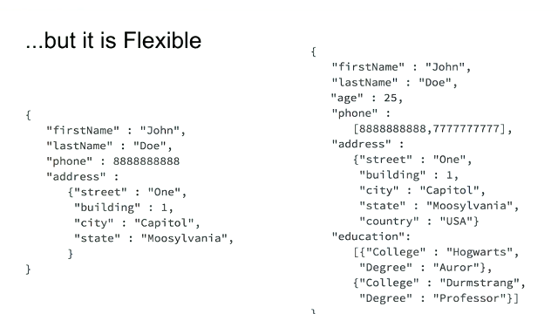
Sample of Document
string
Array
Int
Sub-document
Array of
sub-document

Slide 5
Concept Comparison: MongoDB & SQL
SQL | MongoDB | Explanation
Database | Database
Table | Collection
Row | Document
Column | Field
Primary Key | Primary Key | MongoDB set “_id” as primary key
Join | Embed / Link
Reading: SQL to MongoDB Mapping Chart: https//docs.mongodb.com/manual/reference/sql-comparison/

Slide 6
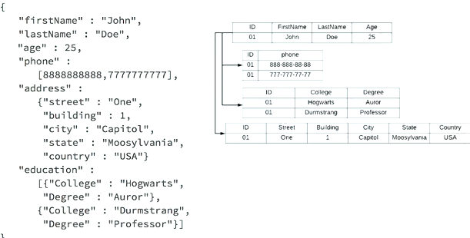
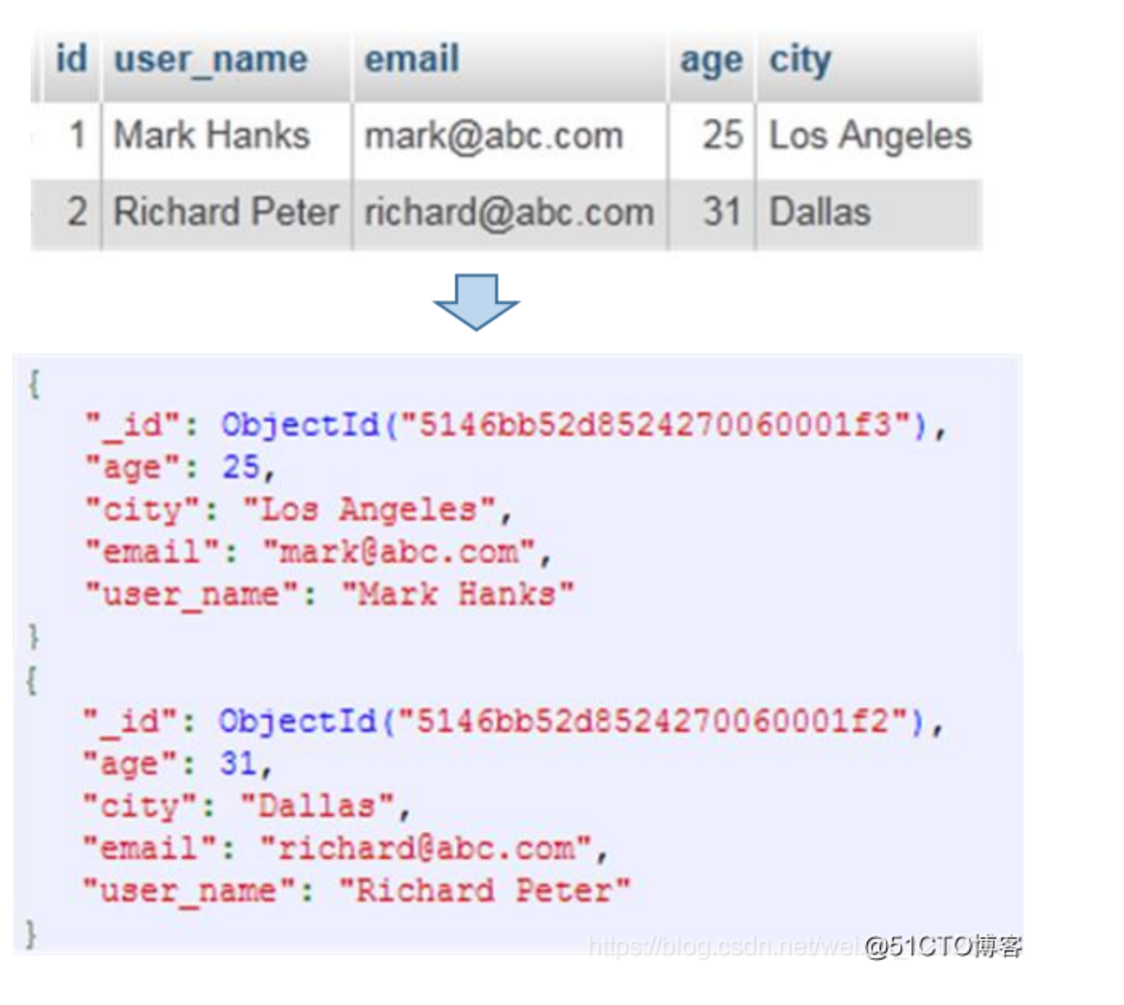
Concept Comparison

Slide 7
MongoDB Tools
MongoDB Compass: graphical user interface (GUI) for managing MongoDB server.
MongoDB Shell: command-line interface (CLI) for managing MongoDB server.
MongoDB Connectors: to connect the server to different tools and programming languages, such as Power BI, Spark, VS Code, etc.
MongoDB Atlas: deploy MongoDB on cloud.

Slide 8
MongoDB Compass
Make sure that MongoDB service is running
    Check the status on Services tab of Windows' Task Manager
Click Connect to get connected to the MongoDB server
    Server Address: Localhost
    Server Port: 27017
Database panel lists all databases in the server
    There are three default databases.
    Create a new database, you need to provide the name of the database and a collection.
    Click on new database to see list of its collections. You can create a new collection here.
    Click on a connection name to see its document list.
    Click Add Data bottom to directly insert a document or import a Json or csv file

Slide 9
MongoDB Shell
Connect to MongoDB server in MongoDB Compass
At the bottom of the Window, click on ">_MangoSH Beta" link
This opens MongoDB shell, a CLI for MongoDB (already connected to server)
A combination of MongoDB commands and JavaScript can be used to manage MongoDB server
    db: shows the current database. The shell starts at Test
    use <db>: switches databases
    db.getCollectionNames(): lists name of collections in db
    db.getCollectionInfos(): lists various information about collections in db
    db.col.find(): lists all documents in the collection col

Slide 10
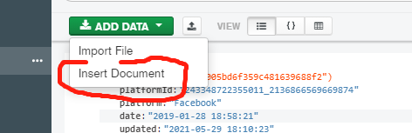
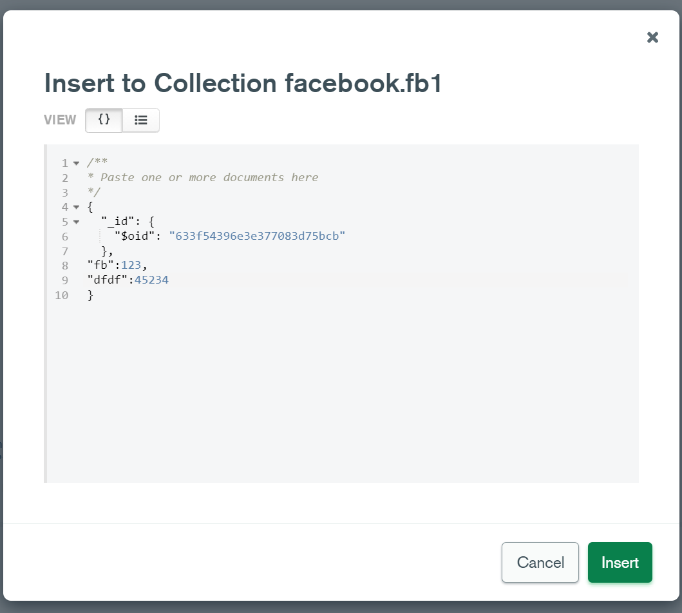
MongoDB CRUD Operations
Create: Adds new document to a collection
  db.<col name>.insertOne(doc)
  db.<col name>.insertMany([doc1,doc2,…,docN])
show dbs # display all the databases
use Facebook # select database
db.fb1.insertOne ({"Page Name": "my_fb"})
db.fb1.insertMany([{"Page Name": "my_fb"},{"test":1}])
db.fb1.find({"Page Name":"my_fb"})

Slide 11
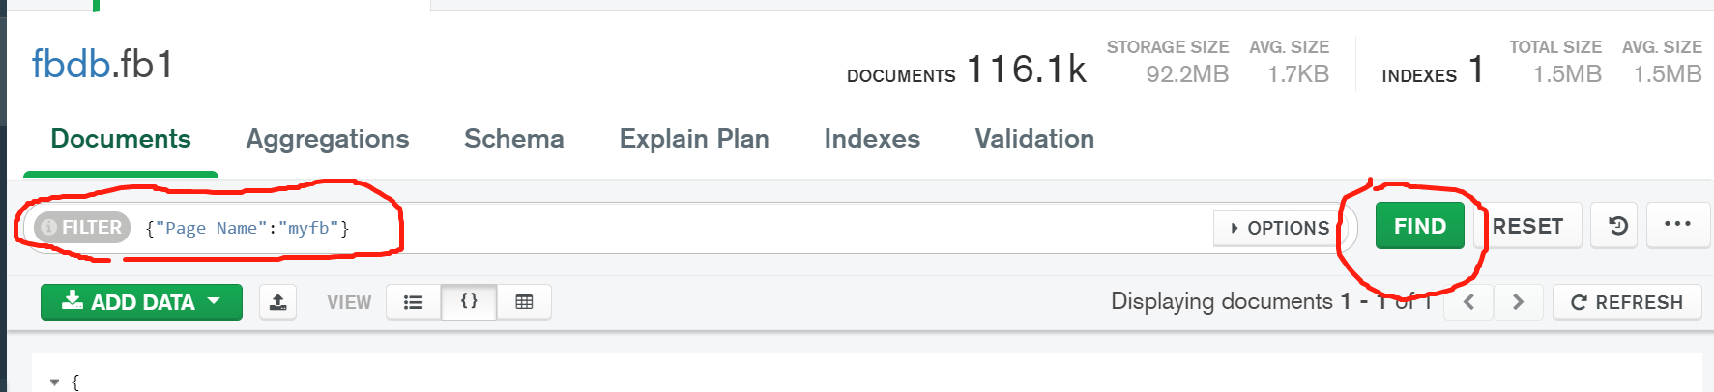
MongoDB CRUD Operations
Read: Queries a collection for documents (Think of SELECT in SQL)
  db.<col name>.find(query)
db.fb1.find ({"Page Name":"eBay"})
db.fb1.find({"Page Name":"eBay"}).count()
db.fb1.find ({"Page Name":"eBay", "Type":"Link"}). pretty()

Slide 12
MongoDB CRUD Operations
Read:
Query Operator : {<field> : { <operator>:<value>}}
$in : Matches any of the values specified in an array.
$eq: Matches values that are equal to a specified value.
…
Logical Operator: {<operator> :[{statement1},{statement2},…]}
$and, $not, $or …
You can find other operators in MongoDB documentation:
https://docs.mongodb.com/manual/reference/operator/query/
  db.fb1.find({"Page Name":"eBay", "Type": {$in: ["Link", "Photo"]}})
  db.fb1.find({$and: [{"Likes":{$gt:1}},{"Type":{$in:["Link","Photo"]}}]})
  db.fb1.find({"test": {$exists: true}})
  {"Page Name":"eBay"} == {"Page Name":{"$eq":"eBay"}}

Slide 13
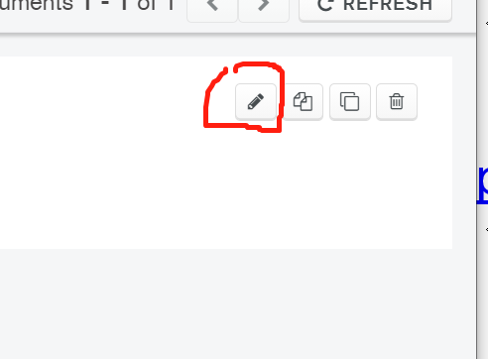
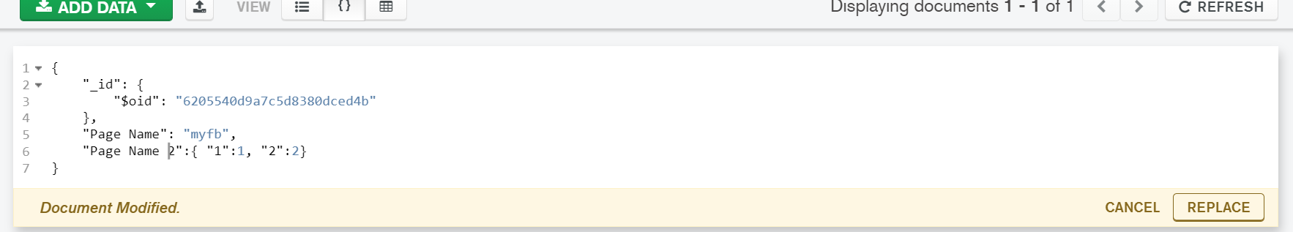
MongoDB CRUD Operations
Update: Update a set of documents with given filter
  db.<col name>.updateOne(<update filter>,<update action>)
  db.<col name>.updateMany(<update filter>,<update action>)
  Update operator: $inc, $set, etc
  (https://docs.mongodb.com/manual/reference/operator/update/)
  db.fb1.updateMany({"Page Name":"eBay"},{"$inc":{"Likes":3}})
  db.fb1.updateMany({"Page Name":"eBay"},{"$set":{"Likes":3}})

Slide 14
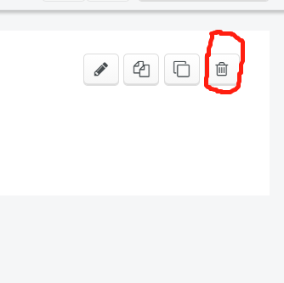
MongoDB CRUD Operations
Delete: Delete a set of documents with given filter
  db.<col name>.deleteOne({<field1>: { <operator1>: <value1> }, ... })
  db.<col name>.deleteMany({<field1>: { <operator1>: <value1> }, ... })
  db.fb1.deleteMany({"Page Name":"eBay"}, {"Likes":{$gt:10}})
  db.fb1.deleteMany({"Page Name":"eBay"})

